Slide 1
Employee Data Analysis using Excel
STUDENT NAME: S.Joicemary
REGISTER NO: 312220249
DEPARTMENT: 3rd B.COM (GENERAL)
COLLEGE: JEPPIAAR COLLEGE OF ARTS AND SCIENCE

Slide 2
PROJECT TITLE
Employee Performance Analysis using Excel

Slide 3


AGENDA
Problem Statement
Project Overview
End Users
Our Solution and Proposition
Dataset Description
Modelling Approach
Results and Discussion
Conclusion
3/21/2024 Annual Review

Slide 4

PROBLEM STATEMENT
To Analyse Performance of the Employee with current employee rating given in the Employee Performance data set.

Slide 5

PROJECT OVERVIEW
.
This project evaluates employee performance based on ratings from their current employer. Using the employee performance dataset, we'll assess individual and overall performance, identify strengths and weaknesses, and provide insights for improvement. The analysis will help employers make informed decisions about employee development and retention."

Slide 6

WHO ARE THE END USERS?
Manager
Managing Director
Supervisors
Employers
Analysts
Employees

Slide 7

OUR SOLUTION AND ITS VALUE PROPOSITION
Conditonal Formatting - To Highlight the Blanks cells and change the font colour of the cell .
Sort & Filter - Filtering the BlankValues.
Pivot Table - Performance Analysis from the Company through Current Employee Rating.
Formulas - IFS (To get the Feedback of Performance )
Graphs- (Bar Chart ) - FINAL REPORT on Employee Performance

Slide 8
Dataset Description
Employee Performance Dataset - IBM Edunet Portal.
Features - 35
Employee status - Text values
Employee type - Text values
Location code - Numerical values
Job function description - Text values
Gender code - Text values
Performance score - Text values
Current employee rating - Numerical values
Feedback - Text values

Slide 9

THE "WOW" IN OUR SOLUTION
New Formula Used : IFS
To Find out the Feedback for Employees Performance by Analysing the Current Employee Rating and Evaluating it.
3/21/2024 Annual Review

Slide 10
MODELLING
Dataset Collection - Employee Performance Dataset
Dataset Preparation - Deleting Blanks, Filtering and Removing Blank data in the Dataset.
Using IFS formula to attain the Feedback for Job Performace through Current Employee Rating (1,2,3,4,5) (Satisfied & Dissatisfied)
Insert Pivot Table to Summarize the Dataset on Employee Performance based on Gender Code , Current Employee Rating , and Feedback of Performance .
Data Visualization using Area Chart to represent the Performnce of the Employee.
Final Report

Slide 11
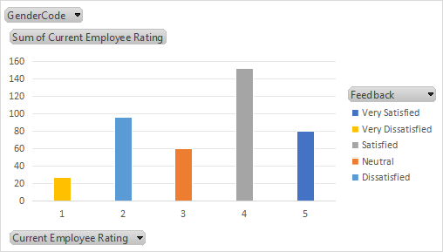
RESULTS

Slide 12
Conclusion
"The analysis reveals that employees with higher ratings excel in teamwork, communication, and problem-solving skills. However, some employees struggle with time management and adaptability. Targeted training programs and regular feedback can enhance overall performance. Employers can use these insights to optimize talent development and improve organizational productivity."

